Slide 1
Q-Learning Curriculum
State, action, reward, deterministic/stochastic,
Bellman Equation
Markov Decision Process
Q-Learning
Temporal Difference
Exploitation vs Exploration
Living Penalty

Slide 2
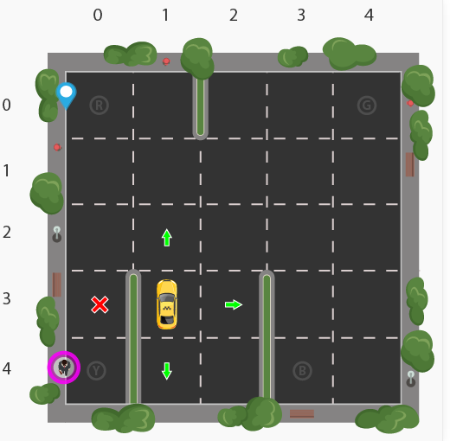
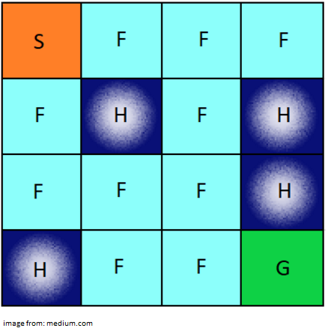
Taxi
Frozen Lake

Slide 3
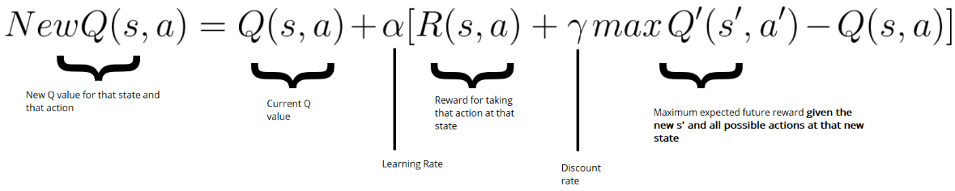
Q-Learning
In Q-learning, the goal is to learn a single deterministic action from a discrete set of actions by finding the maximum value.
Finding the optimal path that maximizes the reward
Terms: Environment-agent, state, action, reward

Slide 4
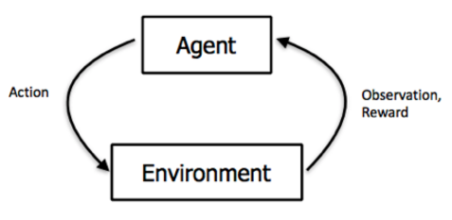
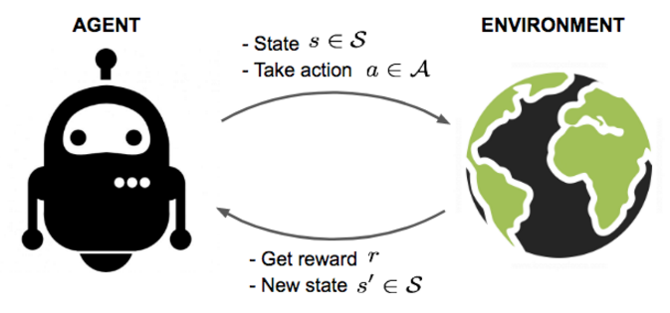

Slide 5
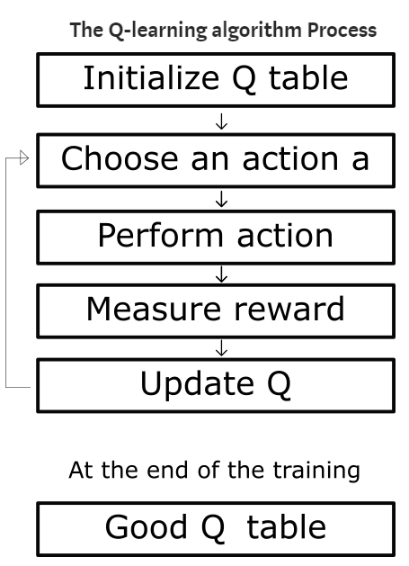
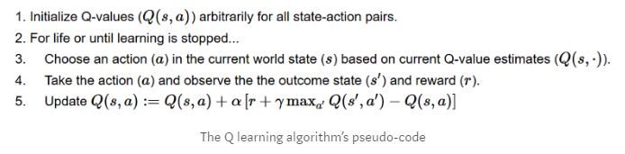

Slide 6
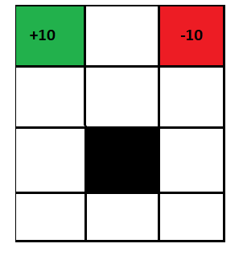
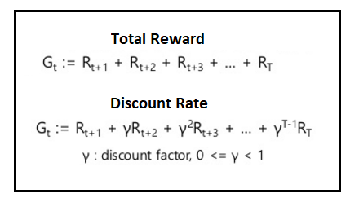
Reward

Slide 7
Gym Taxi
Environment - agent
State , action, reward
Pick up the passenger at one location and drop them off in another
Drop off the passenger to the right location.
Save passenger's time by taking minimum time possible to drop off

Slide 8
Gym Taxi: State
5x5 grid = 25 Cell
4 locations that we can pick up and drop off a passenger: R, G, Y, B
The agent encounters one of the 500 states and it takes an action. 5*5*5*4 = 500

Slide 9
Gym Taxi: Action
Action in our case can be to move in a direction or decide to pickup/dropoff a passenger.
Action Space: South, north, east, west, pickup, dropoff

Slide 10
Gym Taxi: Reward
Positive reward for a successful dropoff (+20)
Negative reward for a wrong dropoff (-10)
Slight negative reward every time-step (-1)
Each successfull dropoff is the end of an episode

Slide 11

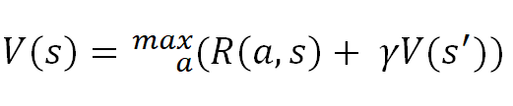
Bellman Equation

Slide 12
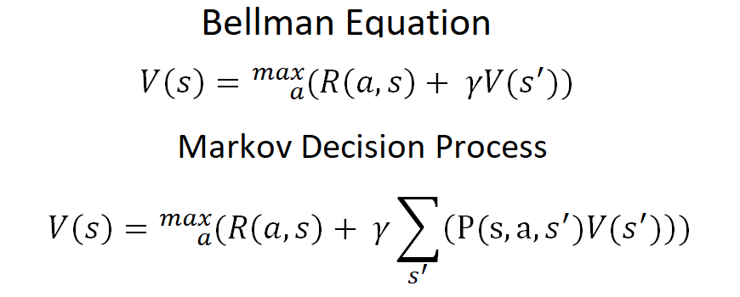
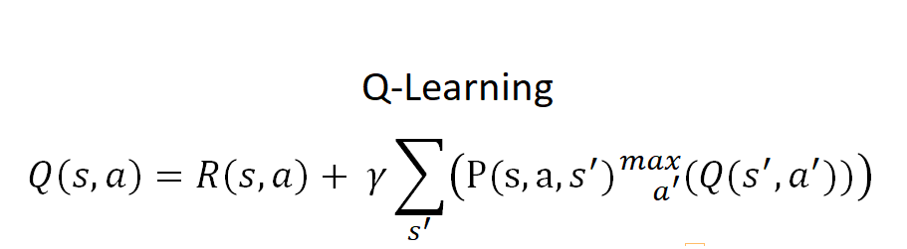

Slide 13
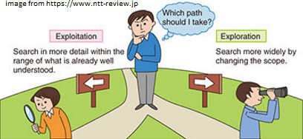



Exploitation vs Exploration

Slide 14
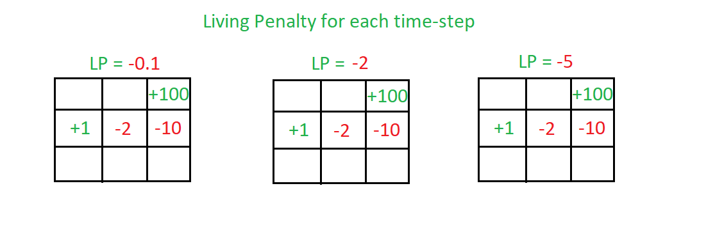
Living Penalty

Slide 15
Gym Taxi Q-Learning
The agent encounters one of the 500 states and it takes an action (6).

Slide 16
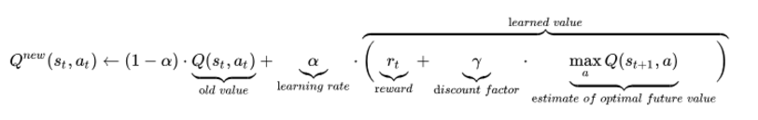
Same Q-functions

Slide 18
FrozenLake-v0
https://gym.openai.com/envs/FrozenLake-v0/
https://github.com/openai/gym/blob/master/gym/envs/toy_text/frozen_lake.py

Slide 19
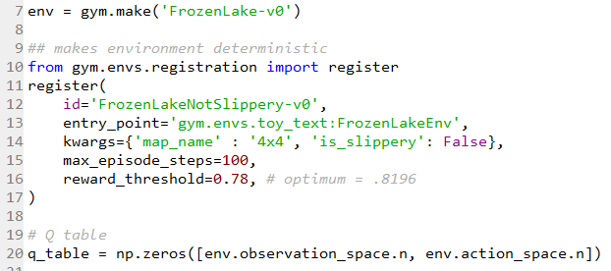

Slide 20
Sonuç
State, action, reward, deterministic/stochastic,
Bellman Equation
Markov Decision Process
Q Learning
Temporal Difference
Exploitation vs Exploration
Living Penalty
Taxi/Frozen Lake
Ek Kaynak: https://www.youtube.com/playlist?list=PLZbbT5o_s2xoWNVdDudn51XM8lOuZ_Njv

Slide 21
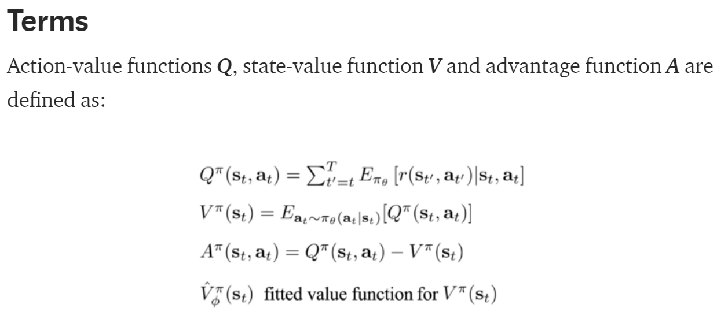
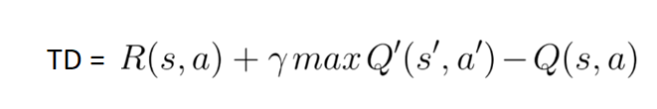

Slide 22
